Slide 1

Preparing Qualitative Data for Analysis
Florio O. Arguillas, Jr., Ph.D.
Research Associate
Cornell Center for Social Sciences
September 5, 2024
291 Clark Hall
Notes:
1

Slide 2
Outline
What is qualitative data?
When do you start analyzing qualitative data?
Other considerations regarding your data, especially its future
Requirements for reporting qualitative research: COREQ
Preparing qualitative data for analysis using CAQDAS
Folder structure
Transcript format
Respondent classification data format
Reference Manager format
Survey format
Video, Audio, pictures, and other formats
Computing and consulting resources
Notes:
2

Slide 3
What is Qualitative Data
Qualitative data are the words, pictures, audio, and/or video generated by researchers and research participants.
Examples of sources of qualitative data are:
In-depth/unstructured interviews, including audio and video
Semi-structured interviews
Structured interview questionnaires containing substantial open comments
Focus groups
Unstructured or semi-structured diaries
Observation field notes/technical fieldwork notes
Case study notes
https://www.dedoose.com/userguide/researchbasics/qualitativeresearch#QualitativeResearch
Notes:
3

Slide 4
When to do your analysis
Concurrent with data collection
Interweave data collection and analysis from the very start
Fieldworker can cycle back and forth between thinking about the existing data and generating strategies for collecting new, often better, data.
A healthy corrective for built-in blind spots
Makes analysis an ongoing, lively enterprise and energizes the process of fieldwork
Early analysis permits the production of interim reports which might be required by funders or adviser
Miles, Huberman, Saldaña (2014)
Notes:
4

Slide 5
When to do your analysis
If you postpone analysis for later i.e., collect all your data first before you start analysis:
Big mistake
Too late to fill in gaps or test new hypothesis that emerge during analysis
Discourages formulation of rival hypotheses that question your assumptions
Makes analysis a giant, overwhelming task that frustrates researchers and reduces the quality of the work produced
Miles, Huberman, Saldaña (2014)
Notes:
5

Slide 6
Qualitative Data Processing Checklist:
Consent
Did you collect personal, confidential, or sensitive information?
Did you gain informed consent for participation from research participants?
Did you discuss data sharing or archiving with the informants from whom you collected the data?
Did you gain consent from informants to share data beyond your research?
Did you explain the data-sharing benefits to participants?
Did you ask for written or verbal consent?
Did you record the consent status as an additional attribute in your respondent classification sheet?
IRB Consent Form Templates | Cornell Research Services
Source: http://datalib.edina.ac.uk/mantra/nvivomodule.html

Slide 7
Qualitative Data Processing Checklist:
Anonymization
Do you need to anonymize data e.g. to remove identifying information or personal data? You will need to think about when this will be done and how.
Have you removed all sensitive materials and replaced them with pseudonyms before importing to a CAQDAS package?
Have you created a backup copy of your originals in a secure storage space before anonymizing them?
Have you developed a de-identification protocol i.e., a description of your de-identification process?
Qualitative Data Repository guidelines
De-identification : https://qdr.syr.edu/guidance/human-participants/deidentification
De-identification protocol: https://data.qdr.syr.edu/file.xhtml?persistentId=doi:10.5064/F6Z60KZB/0NR0VZ
Source: http://datalib.edina.ac.uk/mantra/nvivomodule.html

Slide 8
Qualitative Data Anonymization
Create an anonymization scheme prior to data collection and anonymize data as they are created for analysis ICPSR Guide -https://www.icpsr.umich.edu/files/deposit/dataprep.pdf (pages 31-32)
Replace actual names with generalized text
John to “uncle” ; Mrs. Briggs to “teacher”
More than one person with the same relationship to R can be subscripted to represent each individual
friend1, friend2, friend3…
Demographic information can be substituted for actual names (e.g., M/W/20 for Male, white, 20 years old)
Pseudonyms can be used, however, they many not be as informative to future users as other methods of name replacement.

Slide 9
Qualitative Data Anonymization
Replace dates referring to specific events, such as birthdates with some general marker or placeholder for the information
“month”, “month/year”, or “mm/dd/yy”
Remove unique and/or publicized items
If the item cannot be generalized, the entire text may need to be removed and explicitly marked as such e.g., using either “description of event removed,” or the general indicator “…”
Redact text/images, however, retain format by using placeholders
http://www.nsa.gov/ia/_files/support/i733-028r-2008.pdf
As investigator, use your judgment on whether certain qualitative information in combination with the rest of the text or related quantitative information could allow individual to be identified.

Slide 10
Qualitative Data Processing Checklist:
Copyright
If you are purchasing or re-using someone else’s data sources, have you considered how that data will be shareable?
Have you established who owns the copyright of your data? Might there be joint copyright?
https://www.dfa.cornell.edu/policy/policies/research-data-retention
https://www.dfa.cornell.edu/sites/default/files/policy/vo4_20.pdf
Before archiving your data, have you ensured that all sources to be distributed to third parties have cleared copyright?
Source: http://datalib.edina.ac.uk/mantra/nvivomodule.html

Slide 11
Qualitative Data Processing Checklist:
Documentation
Do you have documentation that explains what your data means or gives context to your data?
Questionnaires used for surveys or semi-structured interviews
Guidance materials used for team-based fieldwork
Instructions for focus group facilitation
Consent forms and information sheets
Approved IRB application
Permissions or licenses from copyright holders
Description of methods used to analyze the data
Description of fieldwork and project context
Description of how derived materials (individual files or variables) were created
Coding schemas
Source: Data Management: https://qdr.syr.edu/guidance/managing/preparing-data

Slide 12
Qualitative Data Processing Checklist:
Formatting and version control
Which data formats will you use? i.e. .rtf, .xls
Are these data formats likely to still be available to use in 10 years time?
If data are held in various places, how will you keep track of versions?
Will you know what the master version of your data files is?
Source: http://datalib.edina.ac.uk/mantra/nvivomodule.html

Slide 13
Qualitative Data Processing Checklist:
Transcription
Who will do the transcription?
How will you ensure the confidentiality and security of your data during the transcription process?
Have you spell-checked your transcripts?
Did you mention hiring a third party to transcribe your data in your IRB application?
Source: http://datalib.edina.ac.uk/mantra/nvivomodule.html
Notes:
13

Slide 14
Qualitative Data Processing Checklist:
Data Access
Who has access to which data during and after research?
Are various access regulations needed?
Source: http://datalib.edina.ac.uk/mantra/nvivomodule.html

Slide 15
Qualitative Data Processing Checklist:
Security
If your data is held on a USB stick or other mobile storage device how will you ensure the safety and security of the data on it?
Are your files backed up regularly and are back-ups stored safely?
How will you securely store personal or sensitive data? (both digital and hard copy data)
Do you need to keep secure all or just part of your data?
Do you have plans for how your data will be preserved once you have finished your research?
Source: http://datalib.edina.ac.uk/mantra/nvivomodule.html

Slide 16
Proliferation of Digital Data
Aldridge, Judith, Juanjo Medina and Robert Ralphs (2010). The problem of proliferation: guidelines for improving the security of qualitative data in a digital age. Research Ethics Review (2010) Vol 6, No 1, 3–9
Notes:
16

Slide 17
Reporting Qualitative Research

Slide 18
Consolidated Criteria for Reporting Qualitative Research (COREQ)
A formal reporting checklist for in-depth interviews and focus groups, the most common methods for data collection in qualitative health research.
The checklist aims to promote complete and transparent reporting among researchers and indirectly improve the rigor, comprehensiveness and credibility of interview and focus-group studies.
http://intqhc.oxfordjournals.org/content/19/6/349.long
https://www.elsevier.com/__data/promis_misc/ISSM_COREQ_Checklist.pdf
Notes:
18

Slide 19
Preparing your Qualitative Data for analysis
Notes:
Now, let’s get into preparing your qualitative data for analysis. Organize your files into one project folder

Slide 20
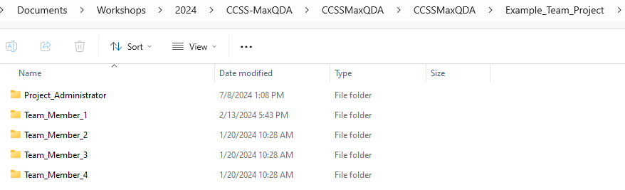
Project Team folder structure

Slide 21
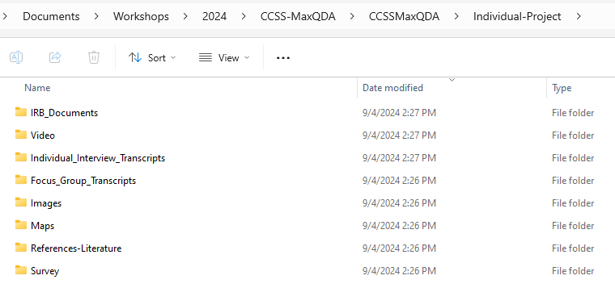
Individual Project folder structure

Slide 22
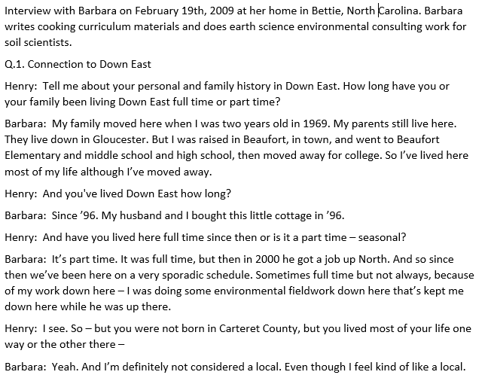
Transcript format

Slide 23
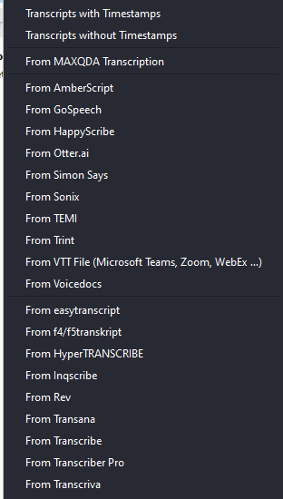
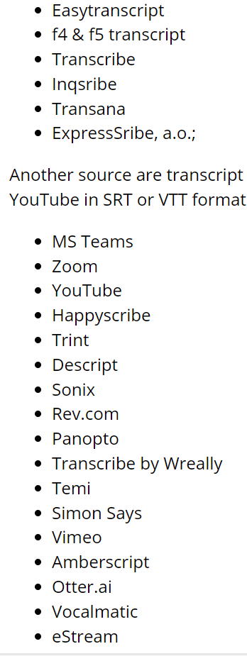
Supported Transcription format or service
MaxQDA
Atlas.ti

Slide 24
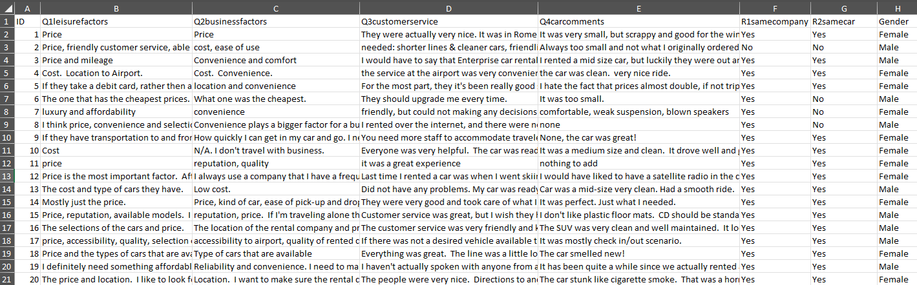
Survey data in Excel format

Slide 25
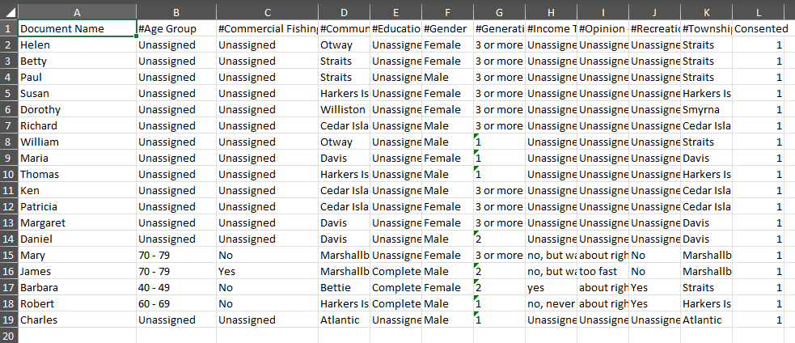
Respondent Classification Sheet format – Atlas.ti

Slide 26
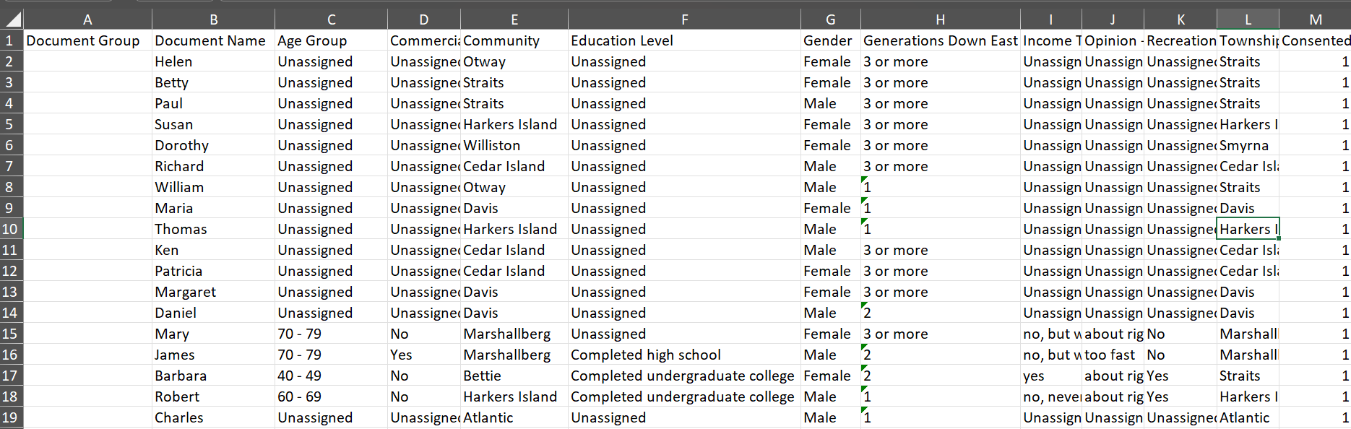
Respondent Classification Sheet format – MaxQDA

Slide 27
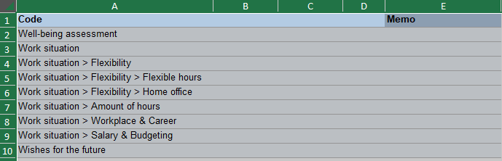
Coding System - MaxQDA
- Code name up to 63 characters long
- Code system up to 10 levels deep

Slide 28
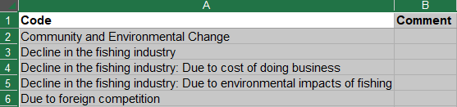
Coding System - Atlas.ti
-The code system is no more than two to three levels deep.
Thus, it consists of folders, categories, and their subcodes.

Slide 29
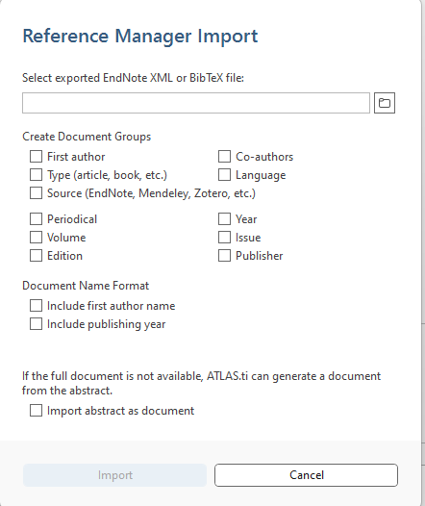
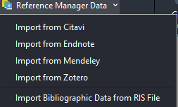
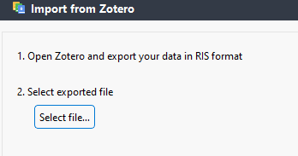
Reference Manager - Literature Review
Atlas.ti
MaxQDA

Slide 30

Supported File Formats
Atlas.ti
MaxQDA
Supported Data Types - MAXQDA

Slide 31
Computing Resources
Apply for a computing account:
https://socialsciences.cornell.edu/computing-and-data/cloud-computing-solutions
Schedule a consultation
https://socialsciences.cornell.edu/computing-and-data/schedule-a-consultation
Email the helpdesk: socialsciences@cornell.edu

Slide 32
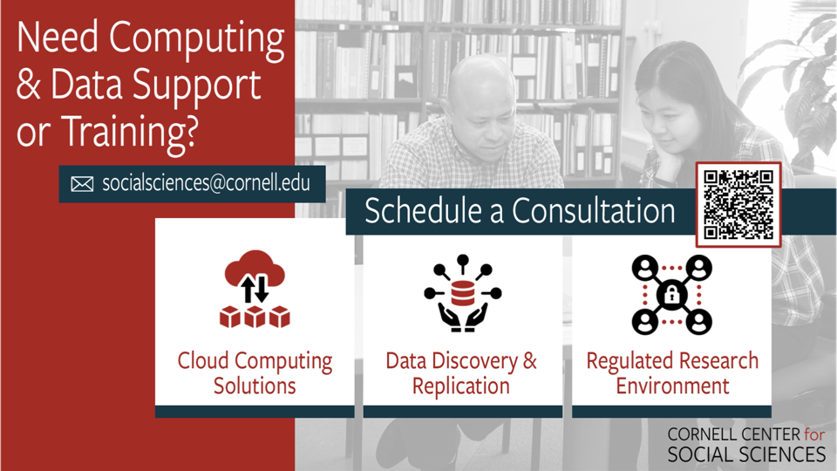

Slide 33
Up Next
September 12, 2024, 12:00 PM – 1:15 PM
Coding and Summarizing Qualitative Data with MaxQDA
September 19, 2024, 12:00 PM – 12:50 PM
Exploring Mixed Methods and Visualization Tools in MaxQDA
Notes:
33

Slide 34
Questions
Email: foa2@cornell.edu
Notes:
34

Slide 35
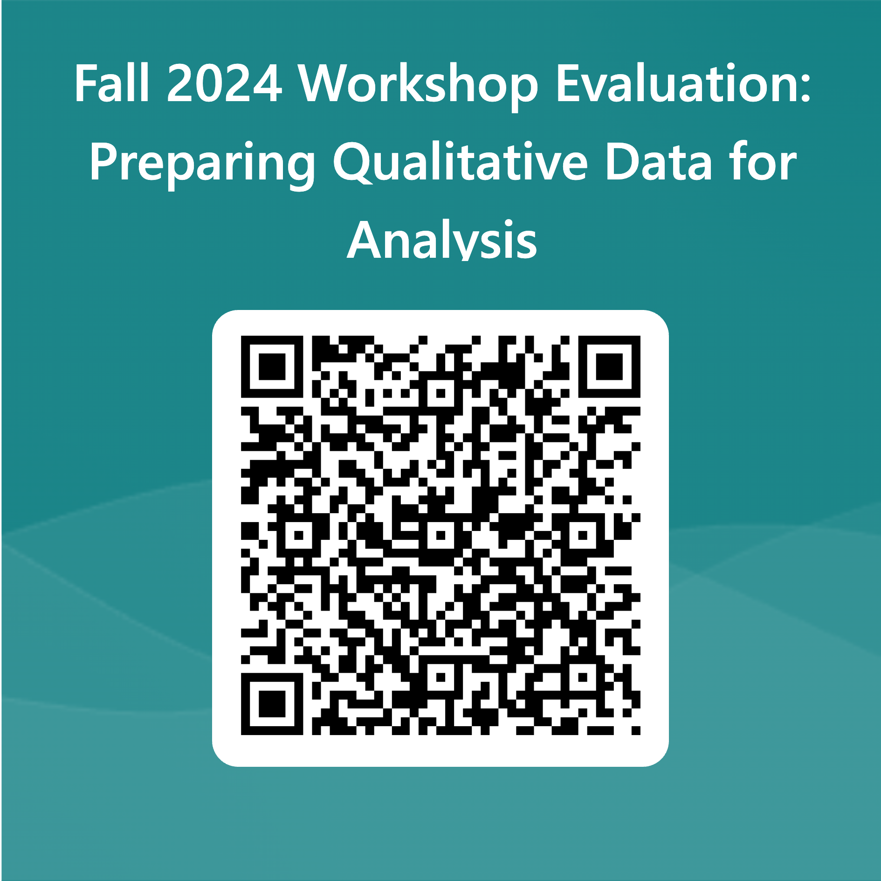
Evaluation

Slide 36
Sources
COREQ
https://onlinelibrary.wiley.com/doi/10.1002/9781118715598.ch21
Five Qualitative Approaches to Inquiry
https://www.sagepub.com/sites/default/files/upm-binaries/13421_Chapter4.pdf
Durdella, Nathan (2019). Qualitative Dissertation Methodology: A Guide for Research Design and Methods. Sage Publications.
Miles, Huberman, Saldana (2014). Qualitative Data Analysis: A Methods Sourcebook. Sage Publications.
Notes:
36

